Slide 1

Presentation
On
6 Months Internship at “Hitachi Solutions India, Pune , Pvt. Ltd.”
Presented by:
Name: Aniket Khadgi
Role: Full Stack Developer Intern
Internship Duration: 8th Jan- 4th July 2025
Project Title: “VibeCart” - An E-Commerce
Platform for Online Shopping
Technologies: ASP.NET Core, Angular , SQL Server
Company Guide:
Mr. Sandesh Rahate
Mr. Hiten Bhatt
Mr. Dinesh Mudharliya
Company : Hitachi Solutions India,
Pune, Pvt. Ltd.

Slide 2
Contents
Company Introduction
Introduction (Project)
Literature Review
Problem Statement
Design and Methodology
Tools and Platform used
Work done till Date
Photos while Working
Conclusion
References

Slide 3
Company Introduction
Name – Hitachi Solutions India, Pune Pvt. Ltd.
Founded : 1910, Tokyo, Japan
Headquarters: Tokyo, Japan
India Locations : Pune, Bangalore, Chennai
Mission: Contributing to society through superior, original technology and products.
About : Hitachi Solutions is a leader in providing industry solutions based on Microsoft dynamics. It provides its customers with industry focus, software industry domain expertise.
Website: www.hitachi.com

Slide 4

Introduction(Project)
VibeCart- An E-Commerce Platform
Platform Purpose: A seamless online shopping experience, 24/7 AI chatbot assistance
Features:
Product Catalogue
User Authentication
Shopping Cart
Order Management
Admin Dashboard
Stock Management

Slide 5
Literature Review
Existing e – commerce websites
Understanding the key features by browsing the websites.
Microsoft and other documentations of the technologies
Exploring more about the technologies used in the project and brainstorming for new idea of how one can make the most use of them in the project.
Hitachi Enterprise Chat.

Slide 6

Problem Statement
Need for a scalable and efficient e-commerce platform
Issues with existing platforms (complexity, security concerns, high costs for small businesses)
Importance of integrating frontend, backend, and database effectively.
Addressing security and performance challenges

Slide 7
Design and Methodology
Architecture:
Three-tier structure: Frontend (Angular), Backend (ASP.NET Core), Database (SQL Server)
Workflow:
User authentication (sign-up/login) using ASP.NET
Product listing and search functionality
Shopping cart and checkout process
Order management system
Security Measures:
JWT Authentication
Role-based access control

Slide 8




Tools and Platform Used
Frontend
Utilizes Angular, TypeScript, and Bootstrap for an interactive user interface.
Backend
C# .NET Core and ASP.NET Web API for backend functionality.
Database
SQL Server for efficient data storage and management.
AI Services
Using Botpress for AI Services.

Slide 9
Work Done
Project Setup:
Created an ASP.NET Core project (EcommerceAPI) in Visual Studio.
Configured Angular for frontend development in VS Code.
Set up SQL Server database.
Frontend Development (Angular):
Designed an attractive and user-friendly UI structure for the platform.
Developed user authentication pages (Login & Signup).
Implemented product listing with clickable cards that redirect to detailed product pages.
Developed user profile section with editable account details.
Added “Your Orders” and “Track Order” UI showing product, order status, and shipping details.
Added Admin Dashboard ,Stock Management, Product Management.
Backend Development (ASP.NET Core):
Created API endpoints for user authentication (Signup, Login)
Developed secure APIs for product listing, product details, cart operations, and order management ,Admin Dashboard.
Integrated payment gateway and order placement logic.
Set up user-specific cart and order tracking using user ID.

Slide 10
Work Done
Testing & Integration:
Connected frontend with backend using RESTful API endpoints.
Using Swagger for testing APIs.
Debugged and optimized performance issues.
Ensured smooth integration of frontend-backend and proper flow of user actions.

Slide 11
Conclusion
Building a functional E-commerce Website
Developed a complete functional E-Commerce platform
Integrated key modules: Auth, Payment, Cart, Orders, Chatbot
Applied ASP.NET Core, Angular, SQL Server, JWT, Botpress
Gained end-to-end full stack development experience
Ready to contribute as a professional Full Stack Developer
AI Chatbot Assistance
Using 24/7 chatbot assistance to the customers for the queries using Botpress.

Slide 12
Presentation
On
6 Months Internship at “Hitachi Solutions India, Pune , Pvt. Ltd.”
Presented by:
Name: Vrushali Rahate
Role: Full Stack Developer Intern
Internship Duration: 8th Jan- 4th July 2025
Project Title: “TruMedico” –
Technologies: ASP.NET Core, Angular , SQL Server
Company Guide:
Mr. Sandesh Rahate
Mr. Hiten Bhatt
Mr. Dinesh Mudharliya
Company : Hitachi Solutions India,
Pune, Pvt. Ltd.

Slide 13

Introduction (Project)
Your Medico- A Pharmacy Management Website
This Project is an approach to pharmacy management, addressing current operational challenges through digital transformation.
The website’s key features are Updating the medicine stock, upload prescription online, role based authentication, Integration of AI and Payment Gateways.
Furthermore, the project will also include will the transformative role of Artificial Intelligence (AI) in streamlining processes and improving patient outcomes.
This project aims to revolutionize pharmacy management by integrating these advanced technologies, creating a more efficient, secure, and patient-centric system.

Slide 14
Literature Review
Existing pharmacy management systems and their limitation
Understanding the key features by browsing the exisiting websites.
Microsoft and other documentations of the technologies
Exploring more about the technologies used in the project and brainstorming for new idea of how one can make the most use of them in the project.

Slide 15

Problem Statement
Manual Inventory
The manual handling of medicine inventory leads to significant inefficiencies, resulting in stock discrepancies and delays in fulfilling prescriptions.
Prescription Errors
Traditional processes are prone to errors in prescription processing and medicine dispensing, potentially endangering patient safety and requiring extensive error correction protocols.
Customer Authentication
The lack of real-time customer authentication and purchase tracking hampers personalized service and increases the risk of fraudulent activities.

Slide 16

Design and Methodology
Layered Architecture
Adopting a 3-layer architecture—Application Layer, Business Layer, and Database Layer—enhances system scalability, maintainability, and security.
Core Modules
Includes Medicine Management (add, update, delete stock), AI Prescription Scanning (OCR-based extraction), User Authentication (admin & customer roles with JWT security), and Customer Records Management (purchase history & prescription tracking).
Seamless Workflow
The workflow starts with user uploading a prescription. Then AI extracts data. The system suggests medicines. The user selects and pays. Finally, the order is processed.
Payment Integration
Payment Gateway Integration facilitates secure online transactions through services like Razorpay, streamlining the payment process for customers.

Slide 17
Work Done (Till Date)
UI of Login and Register Page
Using Angular in VS Code
Backend Coding for Register Page
Creating a Web Api using ASP.NET Core Web Api in visual studio, Adding Controller to handle the register logic
Integrating Backend and SQL Database
Launching the data on SwaggerUI for testing purposes and successfully saving the data in SQL Database
Admin Module
Admin Dashboard
Admin Login with secure access
Add, edit, or delete medicines
Assign categories to medicines
View all medicines in stock.

Slide 18
Work Done
User Module
User Registration & Login (JWT Authentication)
Browse medicines by categories
Add medicines to cart
Modify quantity in cart (increase/decrease)
View product description
Cart & Checkout
Dynamic cart with real-time price update
Checkout with selected address
Integration with Cashfree for mock paymentAuto-fetch total price from backend
Backend Integration (C# .NET)
RESTful APIs for user, admin, medicine, orders, cart, and payment
JWT-based authentication and role-based access control( Admin and Customer)
SQL Database to store all entities: Users, Medicines, Orders, Categories, Addresses

Slide 19
Work Done
Frontend
User friendly and Lovable UI
Integrated completely with the backend
Payment Gateway
Used Stripe Payment Gateway for online payment.
Implementation of Cash on Delivery option.
Stock Management
Generated unique Order Id for each order
Admin dashboard functionalities

Slide 21
Conclusion
Improved Efficiency
The system significantly improves pharmacy management efficiency by automating key processes and reducing manual workloads.
AI Prescription Scanning
AI-based prescription scanning offers increased accuracy in data extraction, minimizing errors and enhancing patient safety.
Secure Payments
Secure and seamless customer authentication and payments facilitate a hassle-free and trustworthy experience.

Slide 22
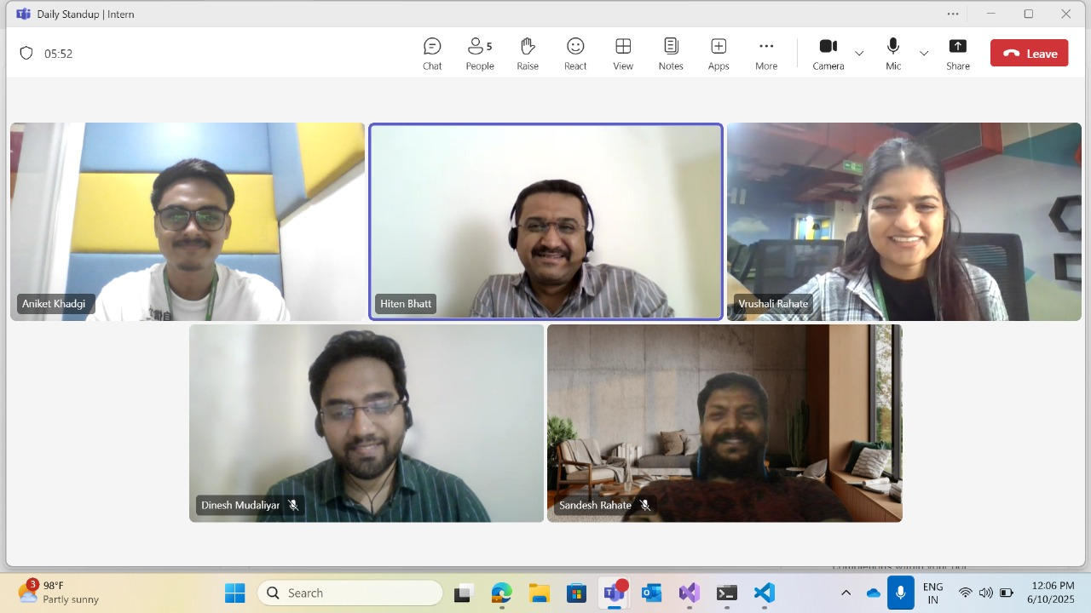
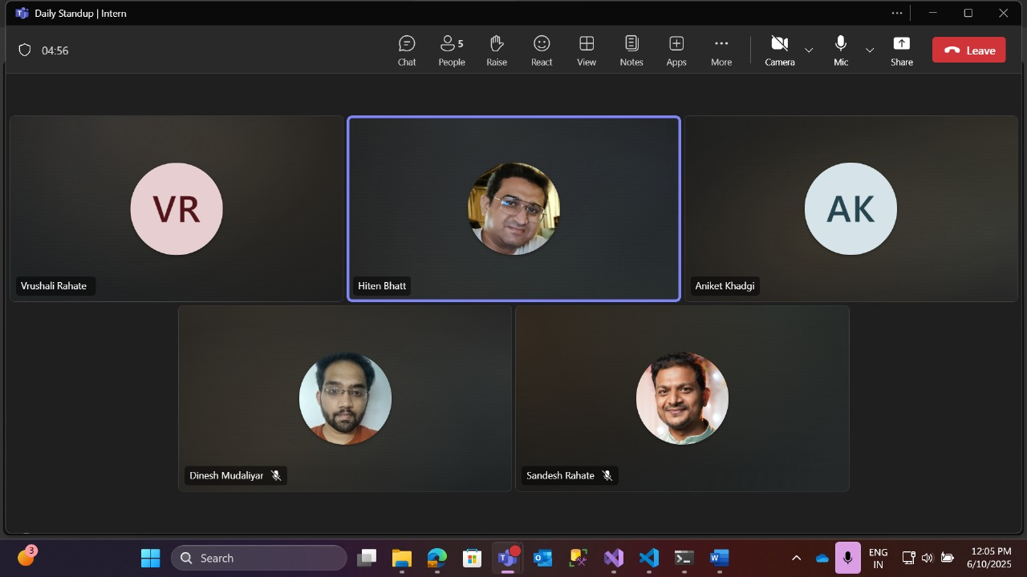
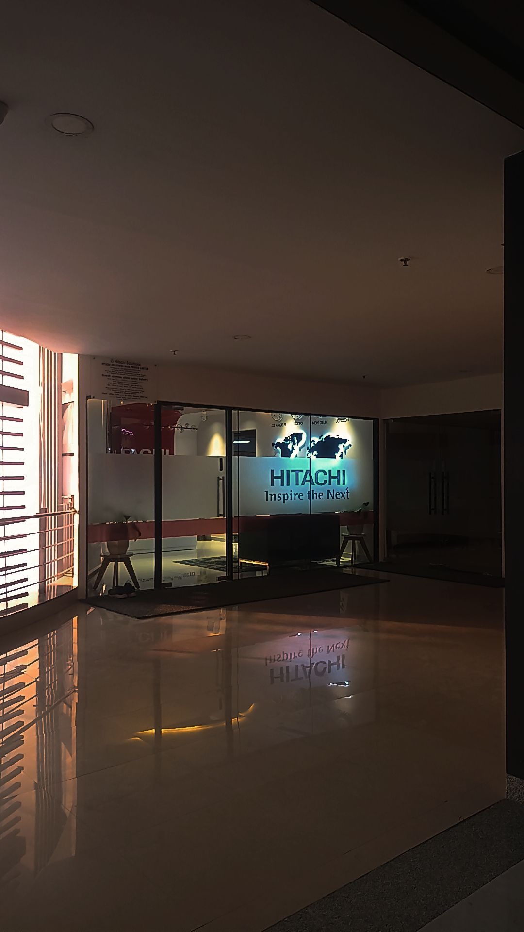
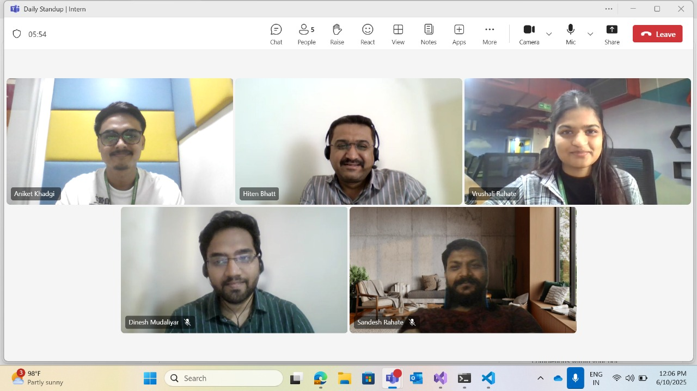
Photos (G Tag) While Working

Slide 23
References
1. Microsoft Docs – ASP.NET Core Web API https://learn.microsoft.com/en-us/aspnet/core/web-api
2. Angular Official Documentation https://angular.io/docs
3. Stripe API Documentation – Refunds https://stripe.com/docs/api/refunds
4. Entity Framework Core – Microsoft Docs https://learn.microsoft.com/en-us/ef/core/
5. W3Schools – Web Development Tutorials https://www.w3schools.com
6. GeeksforGeeks – Full Stack Project Resources https://www.geeksforgeeks.org
7. Hitachi Enterprise Chat

Slide 24
Thank You

